Slide 1
Excel Basics

Slide 2
Basic definitions
Cell
Row
Column

Slide 3
Organizing Data
Column and row labels
Widen columns

Slide 4
Functions: Basic Math
Addition: =X+Y
Subtraction: =X-Y
Multiplication: =X*Y
Division: =X/Y
Average: =average( )

Slide 5
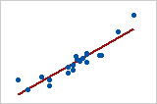
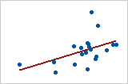
Functions: Other Calculations
Range: =Final-Initial
Standard Deviation: =stdev.s( )
stdev.s → standard deviation of sample
stdev.p → standard deviation of population
How much does your population vary from the average?
Not much (low standard deviation)
A lot (high standard deviation)
2017 Minitab Inc.

Slide 6
Graphs: Formatting Data
Highlight the data you want in your graph
Go to the Insert tab
Select the type of graph you want
X-axis values
Y-axis values

Slide 7
Graphs: Axis Labels
Click the + next to the graph
Select whatever chart elements you want to be displayed
Label the x- and y-axes
Get rid of the title (science uses captions instead)

Slide 8
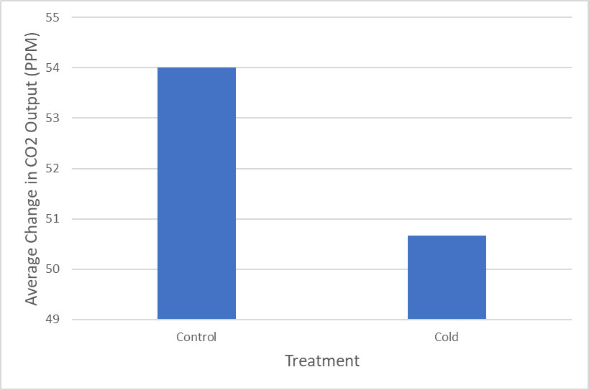
Properly Formatted Graph
No title
Properly labeled axes
Graph easy to read & interpret
Caption should provide a brief description of the content of the graph
Figure 1. Average change in CO₂ output (PPM) in control treatment (22.4ºC) and cold treatment (12.2ºC).

Slide 9
Functions: Slope
y = mx + b
m → slope
b → y-intercept
Rise over run
Slope: =slope(Y-values , X-values)
Run
Rise

Slide 10
Graphs: Line of Best Fit, Slope
You can add a Trendline
Produces the line best suited to your data
You can display the equation of the line as well
Another way of finding the slope

Slide 11
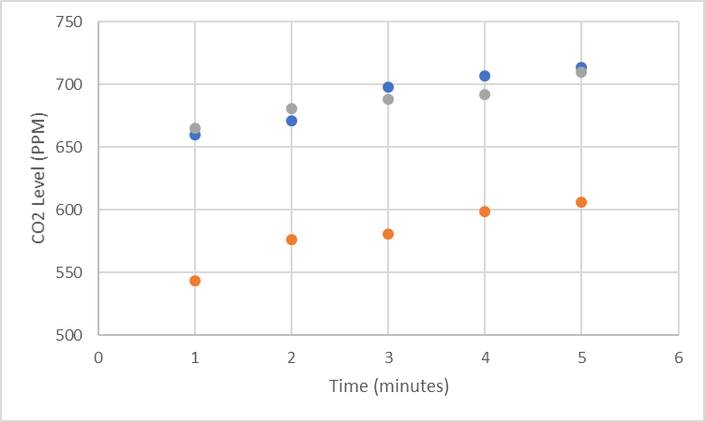
Graphs: Choosing the Best Graph
Take a preliminary look at data
Figure 1. Changes in CO₂ levels in 3 different trials at ambient temperature (22.4ºC).

Slide 12
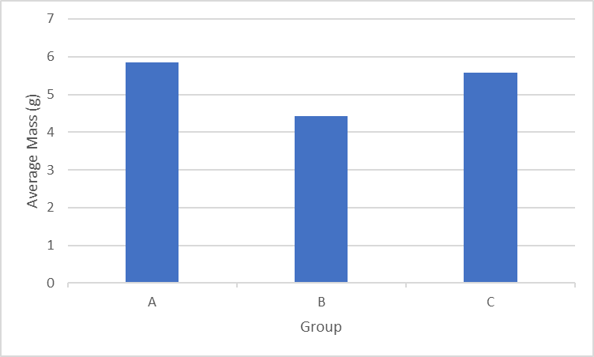
Graphs: Choosing the Best Graph
Compare average mass between groups
Figure 1. Average mass (g) for 3 different treatment groups.

Slide 13
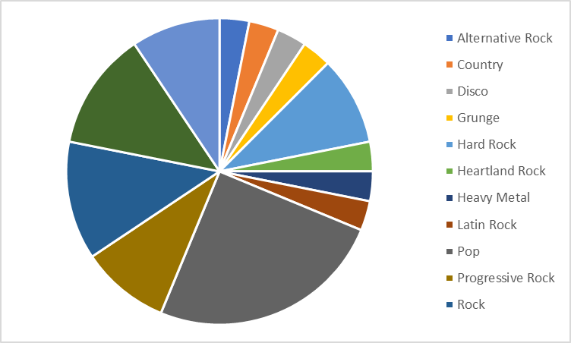
Graphs: Choosing the Best Graph
Show a comparison between different genres and their occurrence in the Top 32 Best-Selling Albums
Figure 1. The distribution of the Top 32 Best-Selling Albums by genre.

